Slide 1
Graphs

Slide 2
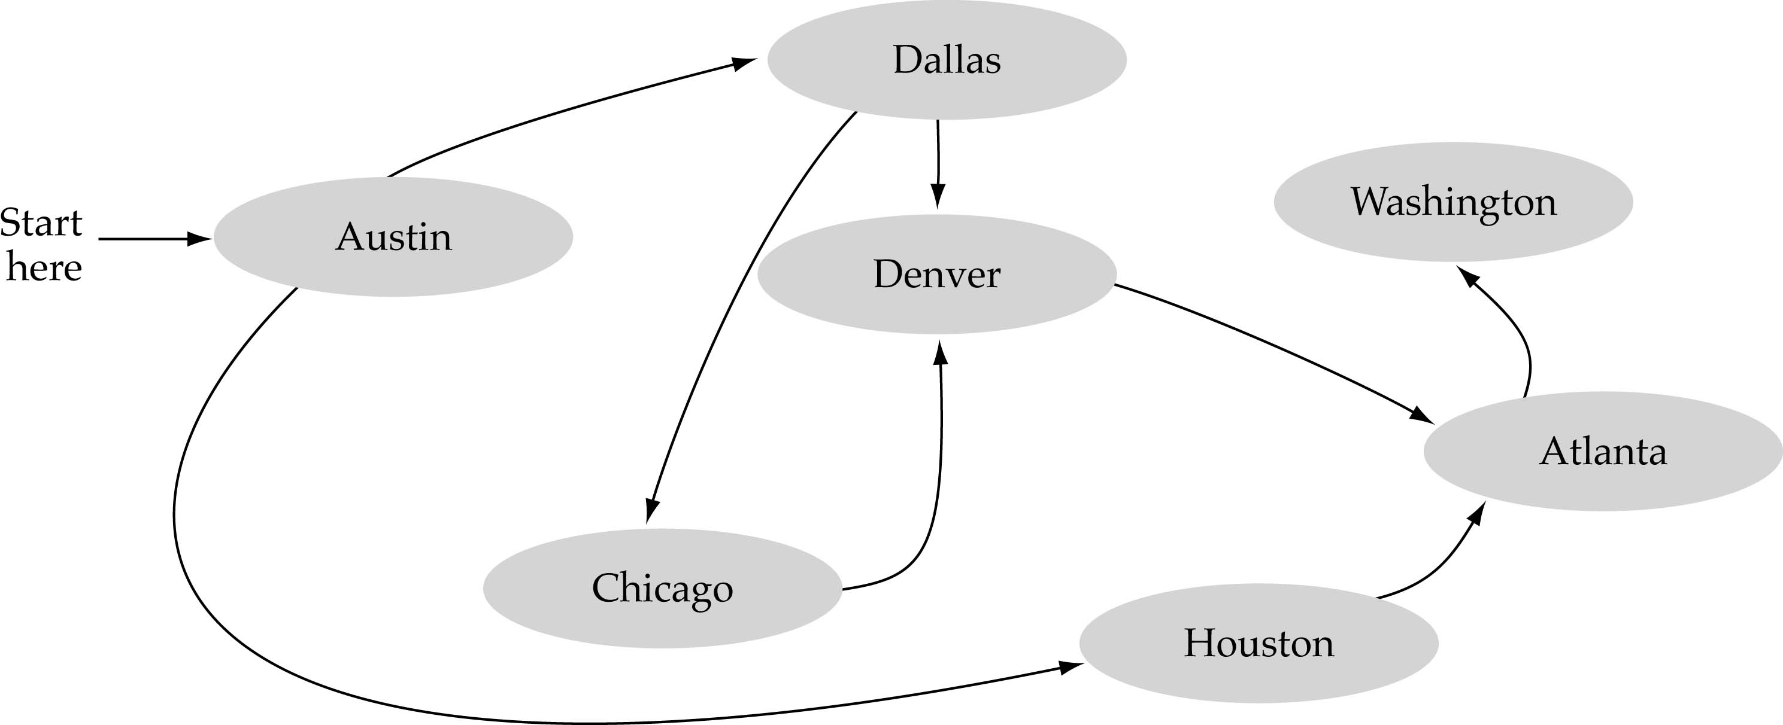
What is a graph?
A data structure that consists of a set of nodes (vertices) and a set of edges that relate the nodes to each other
The set of edges describes relationships among the vertices

Slide 3
Formal definition of graphs
A graph G is defined as follows:
G=(V,E)
V(G): a finite, nonempty set of vertices
E(G): a set of edges (pairs of vertices)

Slide 4
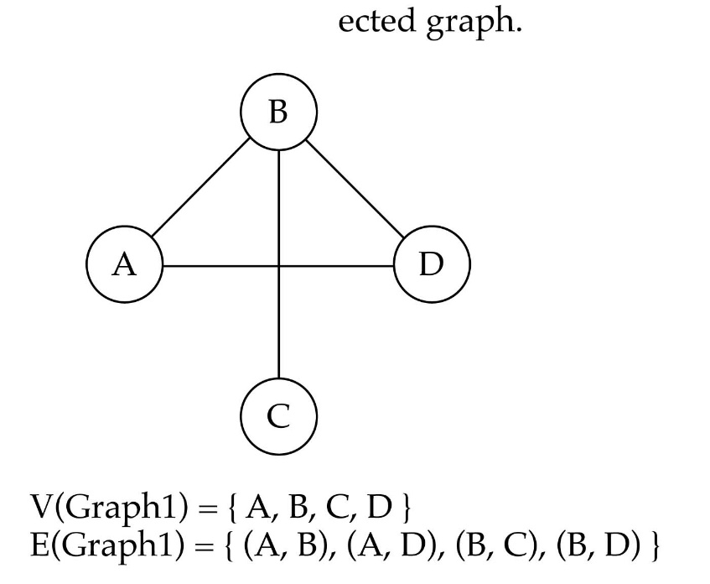
Directed vs. undirected graphs
When the edges in a graph have no direction, the graph is called undirected

Slide 5

Directed vs. undirected graphs (cont.)
When the edges in a graph have a direction, the graph is called directed (or digraph)
Warning: if the graph is directed, the order of the vertices in each edge is important !!
E(Graph2) = {(1,3) (3,1) (5,9) (9,11) (5,7)

Slide 6

Trees vs graphs
Trees are special cases of graphs!!

Slide 7

Graph terminology
Adjacent nodes: two nodes are adjacent if they are connected by an edge
Path: a sequence of vertices that connect two nodes in a graph
Complete graph: a graph in which every vertex is directly connected to every other vertex
5 is adjacent to 7
7 is adjacent from 5

Slide 8
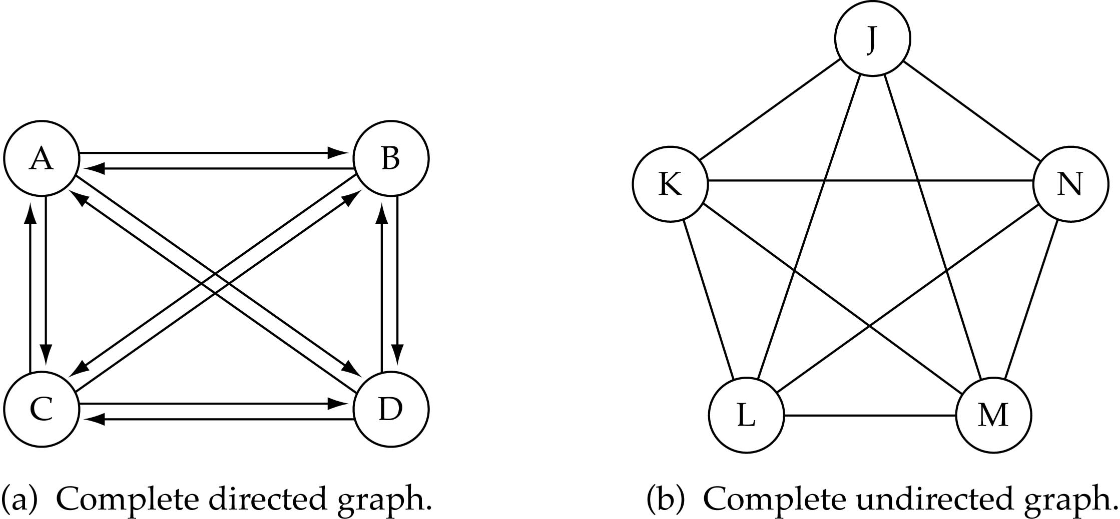
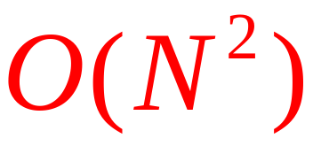
Graph terminology (cont.)
What is the number of edges in a complete directed graph with N vertices?
N * (N-1)

Slide 9
Graph terminology (cont.)
What is the number of edges in a complete undirected graph with N vertices?
N * (N-1) / 2

Slide 10
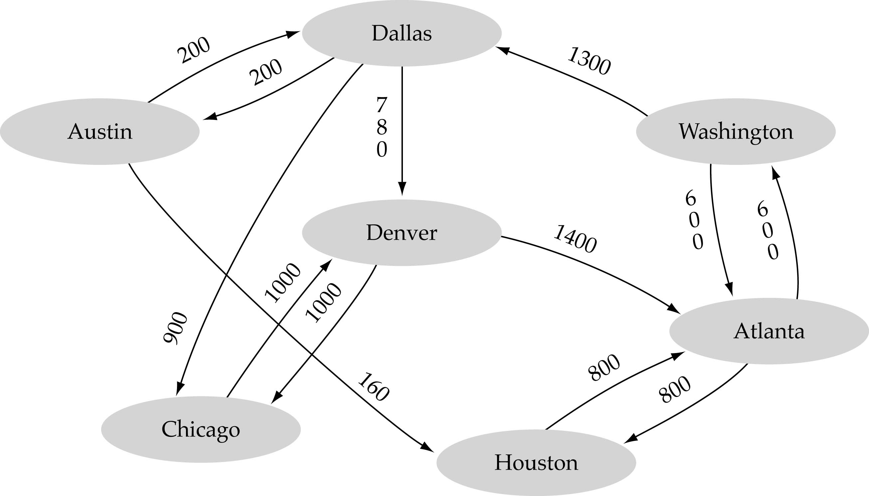
Graph terminology (cont.)
Weighted graph: a graph in which each edge carries a value

Slide 11
Graph implementation
Array-based implementation
  A 1D array is used to represent the vertices
  A 2D array (adjacency matrix) is used to represent the edges

Slide 12
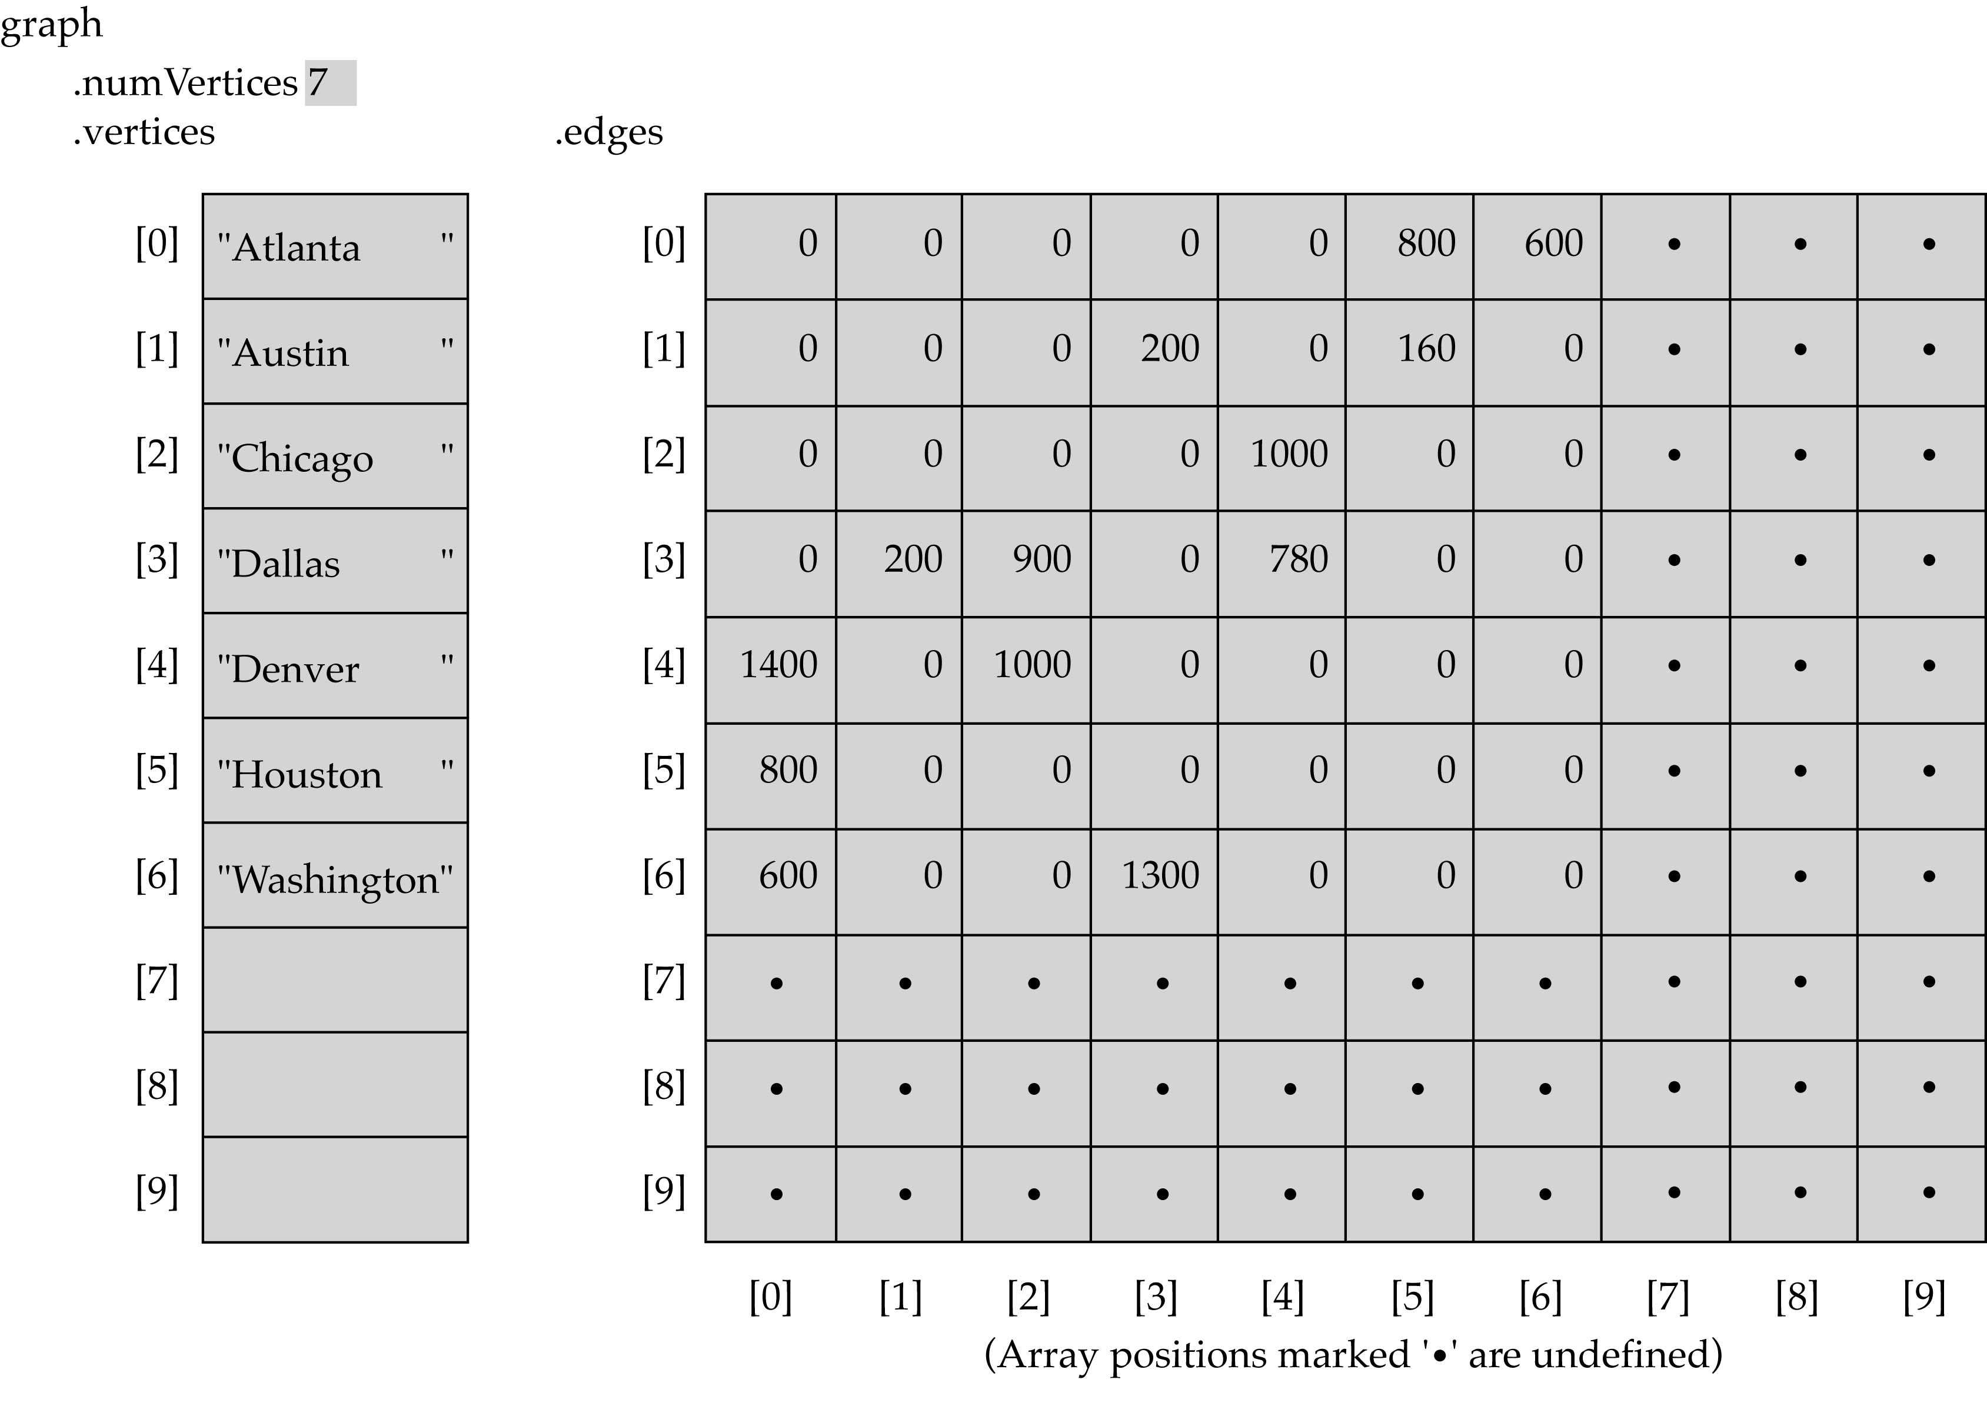
Array-based implementation

Slide 13
Graph implementation (cont.)
Linked-list implementation
  A 1D array is used to represent the vertices
  A list is used for each vertex v which contains the vertices which are adjacent from v (adjacency list)

Slide 14
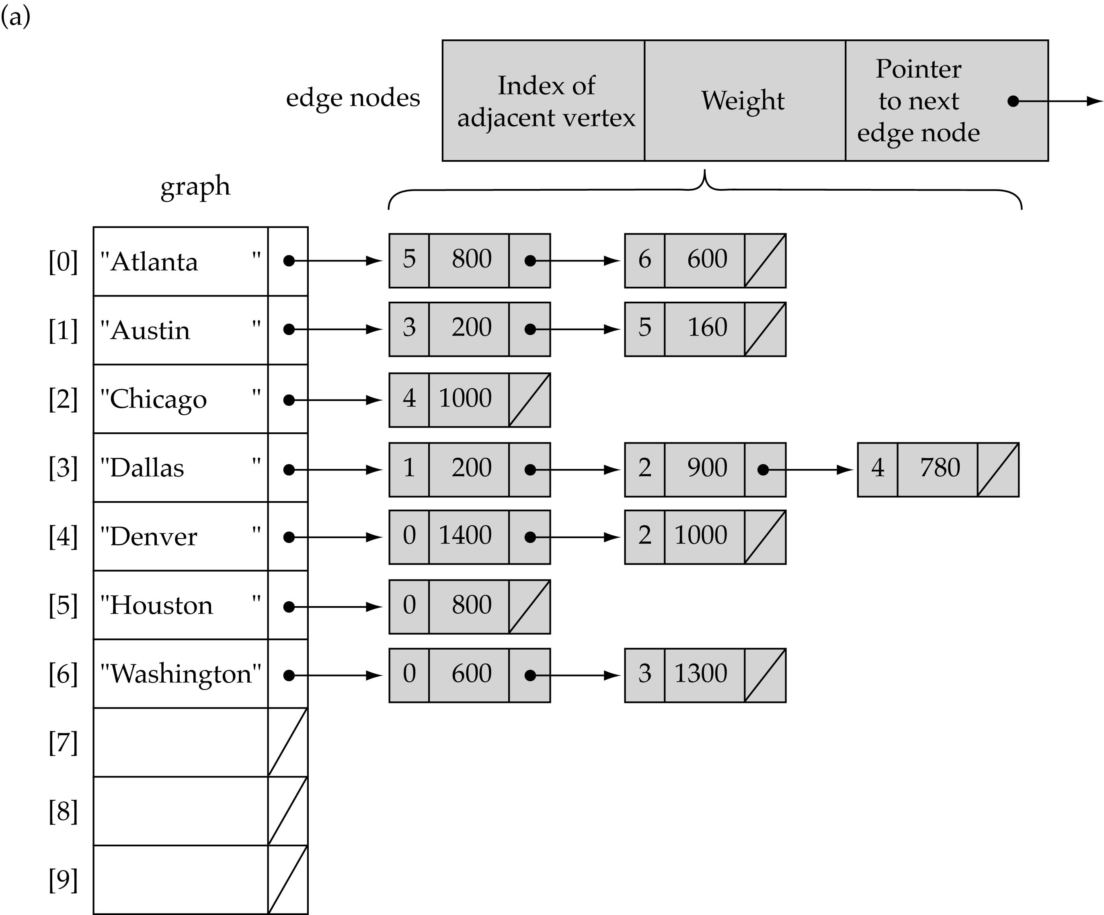
Linked-list implementation

Slide 15
Adjacency matrix vs. adjacency list representation
Adjacency matrix
  Good for dense graphs --|E|~O(|V|²)
  Memory requirements: O(|V| + |E| ) = O(|V|² )
  Connectivity between two vertices can be tested quickly
Adjacency list
  Good for sparse graphs -- |E|~O(|V|)
  Memory requirements: O(|V| + |E|)=O(|V|)
  Vertices adjacent to another vertex can be found quickly

Slide 16
Graph specification based on adjacency matrix representation
const int NULL_EDGE = 0;
template<class VertexType>
class GraphType {
public:
GraphType(int);
~GraphType();
void MakeEmpty();
bool IsEmpty() const;
bool IsFull() const;
void AddVertex(VertexType);
void AddEdge(VertexType, VertexType, int);
int WeightIs(VertexType, VertexType);
void GetToVertices(VertexType, QueType<VertexType>&);
void ClearMarks();
void MarkVertex(VertexType);
bool IsMarked(VertexType) const;
private:
int numVertices;
int maxVertices;
VertexType* vertices;
int **edges;
bool* marks;
};
(continues)

Slide 17
template<class VertexType>
GraphType<VertexType>::GraphType(int maxV)
{
numVertices = 0;
maxVertices = maxV;
vertices = new VertexType[maxV];
edges = new int[maxV];
for(int i = 0; i < maxV; i++)
edges[i] = new int[maxV];
marks = new bool[maxV];
}
template<class VertexType>
GraphType<VertexType>::~GraphType()
{
delete [] vertices;
for(int i = 0; i < maxVertices; i++)
delete [] edges[i];
delete [] edges;
delete [] marks;
}
(continues)

Slide 18
void GraphType<VertexType>::AddVertex(VertexType vertex)
{
vertices[numVertices] = vertex;
for(int index = 0; index < numVertices; index++) {
edges[numVertices][index] = NULL_EDGE;
edges[index][numVertices] = NULL_EDGE;
}
numVertices++;
}
template<class VertexType>
void GraphType<VertexType>::AddEdge(VertexType fromVertex,
VertexType toVertex, int weight)
{
int row;
int column;
row = IndexIs(vertices, fromVertex);
col = IndexIs(vertices, toVertex);
edges[row][col] = weight;
}
(continues)

Slide 19
template<class VertexType>
int GraphType<VertexType>::WeightIs(VertexType fromVertex,
VertexType toVertex)
{
int row;
int column;
row = IndexIs(vertices, fromVertex);
col = IndexIs(vertices, toVertex);
return edges[row][col];
}

Slide 20
Graph searching
Problem: find a path between two nodes of the graph (e.g., Austin and Washington)
Methods: Depth-First-Search (DFS) or Breadth-First-Search (BFS)

Slide 21
Depth-First-Search (DFS)
What is the idea behind DFS?
  Travel as far as you can down a path
  Back up as little as possible when you reach a "dead end" (i.e., next vertex has been "marked" or there is no next vertex)
DFS can be implemented efficiently using a stack

Slide 22
Depth-First-Search (DFS) (cont.)
Set found to false
stack.Push(startVertex)
DO
stack.Pop(vertex)
IF vertex == endVertex
Set found to true
ELSE
Push all adjacent vertices onto stack
WHILE !stack.IsEmpty() AND !found
IF(!found)
Write "Path does not exist"

Slide 23
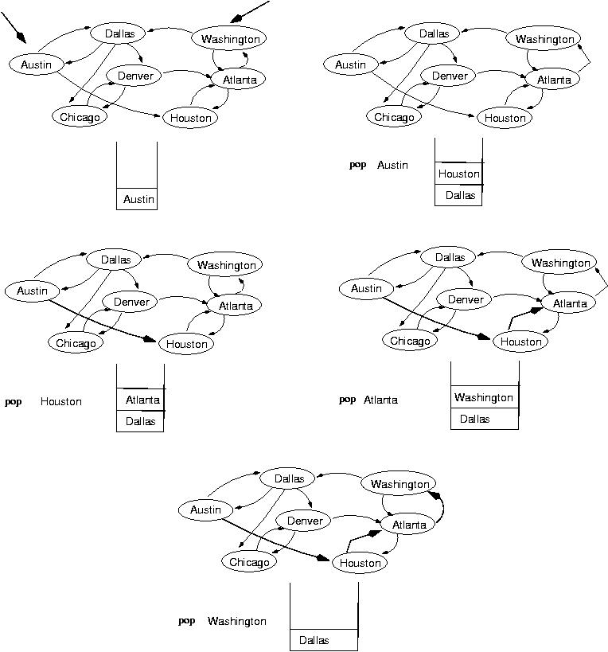
start
end
(initialization)

Slide 26
template <class ItemType>
void DepthFirstSearch(GraphType<VertexType> graph, VertexType startVertex, VertexType endVertex)
{
StackType<VertexType> stack;
QueType<VertexType> vertexQ;
bool found = false;
VertexType vertex;
VertexType item;
graph.ClearMarks();
stack.Push(startVertex);
do {
stack.Pop(vertex);
if(vertex == endVertex)
found = true;
(continues)

Slide 27
else {
if(!graph.IsMarked(vertex)) {
graph.MarkVertex(vertex);
graph.GetToVertices(vertex, vertexQ);
while(!vertexQ.IsEmpty()) {
vertexQ.Dequeue(item);
if(!graph.IsMarked(item))
stack.Push(item);
}
}
} while(!stack.IsEmpty() && !found);
if(!found)
cout << "Path not found" << endl;
}
(continues)

Slide 28
template<class VertexType>
void GraphType<VertexType>::GetToVertices(VertexType vertex,
QueTye<VertexType>& adjvertexQ)
{
int fromIndex;
int toIndex;
fromIndex = IndexIs(vertices, vertex);
for(toIndex = 0; toIndex < numVertices; toIndex++)
if(edges[fromIndex][toIndex] != NULL_EDGE)
adjvertexQ.Enqueue(vertices[toIndex]);
}

Slide 29
Breadth-First-Searching (BFS)
What is the idea behind BFS?
  Look at all possible paths at the same depth before you go at a deeper level
  Back up as far as possible when you reach a "dead end" (i.e., next vertex has been "marked" or there is no next vertex)

Slide 30
Breadth-First-Searching (BFS) (cont.)
BFS can be implemented efficiently using a queue
  Set found to false
  queue.Enqueue(startVertex)
  DO
  queue.Dequeue(vertex)
  IF vertex == endVertex
  Set found to true
  ELSE
  Enqueue all adjacent vertices onto queue
  WHILE !queue.IsEmpty() AND !found
Should we mark a vertex when it is enqueued or when it is dequeued ?
IF(!found)
Write "Path does not exist"

Slide 31
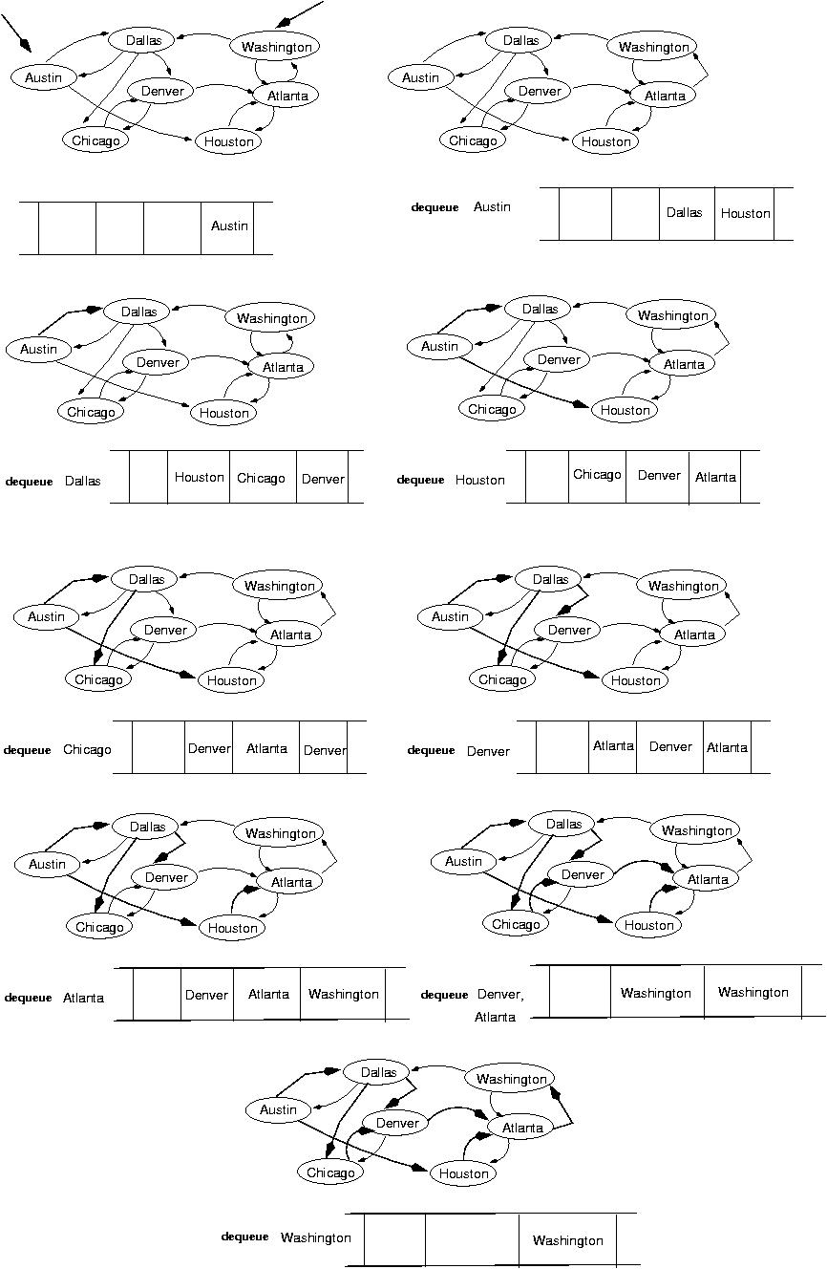
start
end
(initialization)

Slide 32
next:

Slide 34
template<class VertexType>
void BreadthFirtsSearch(GraphType<VertexType> graph, VertexType startVertex, VertexType endVertex);
{
QueType<VertexType> queue;
QueType<VertexType> vertexQ;//
bool found = false;
VertexType vertex;
VertexType item;
graph.ClearMarks();
queue.Enqueue(startVertex);
do {
queue.Dequeue(vertex);
if(vertex == endVertex)
found = true;
(continues)

Slide 35
else {
if(!graph.IsMarked(vertex)) {
graph.MarkVertex(vertex);
graph.GetToVertices(vertex, vertexQ);
while(!vertxQ.IsEmpty()) {
vertexQ.Dequeue(item);
if(!graph.IsMarked(item))
queue.Enqueue(item);
}
}
}
} while (!queue.IsEmpty() && !found);
if(!found)
cout << "Path not found" << endl;
}

Slide 36
Single-source shortest-path problem
There are multiple paths from a source vertex to a destination vertex
Shortest path: the path whose total weight (i.e., sum of edge weights) is minimum
Examples:
  Austin->Houston->Atlanta->Washington: 1560 miles
  Austin->Dallas->Denver->Atlanta->Washington: 2980 miles

Slide 37
Single-source shortest-path problem (cont.)
Common algorithms: Dijkstra's algorithm, Bellman-Ford algorithm
BFS can be used to solve the shortest graph problem when the graph is weightless or all the weights are the same
        (mark vertices before Enqueue)

Slide 38
Exercises
24-37

